Slide 1
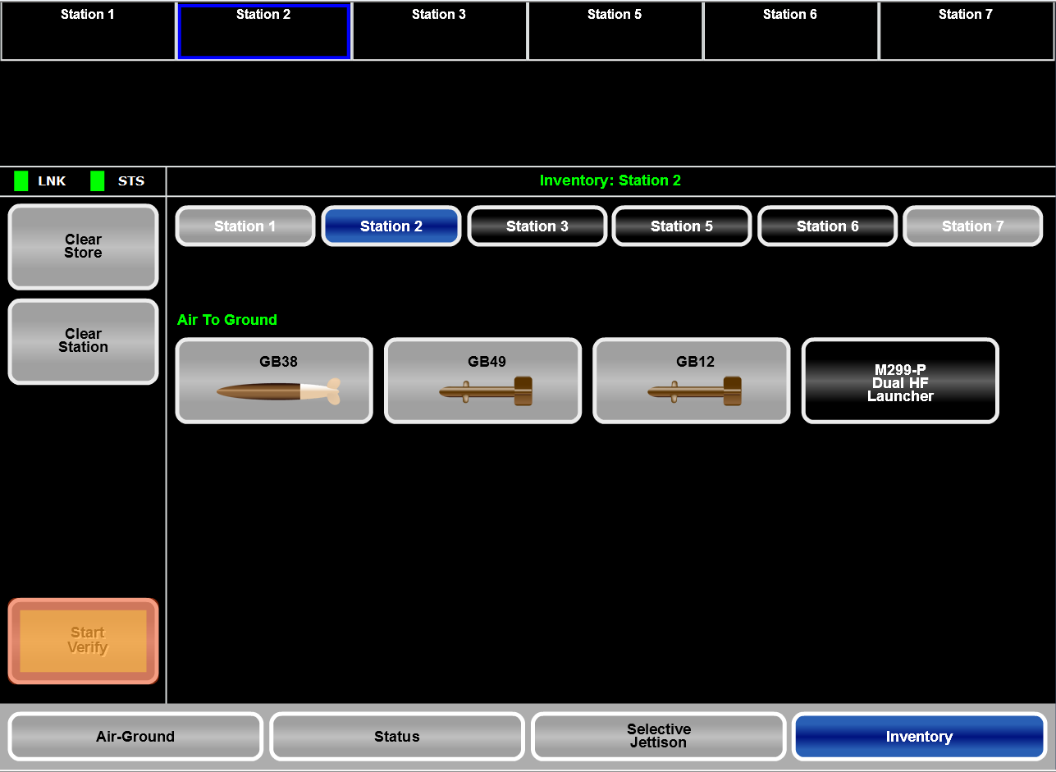

Slide 2
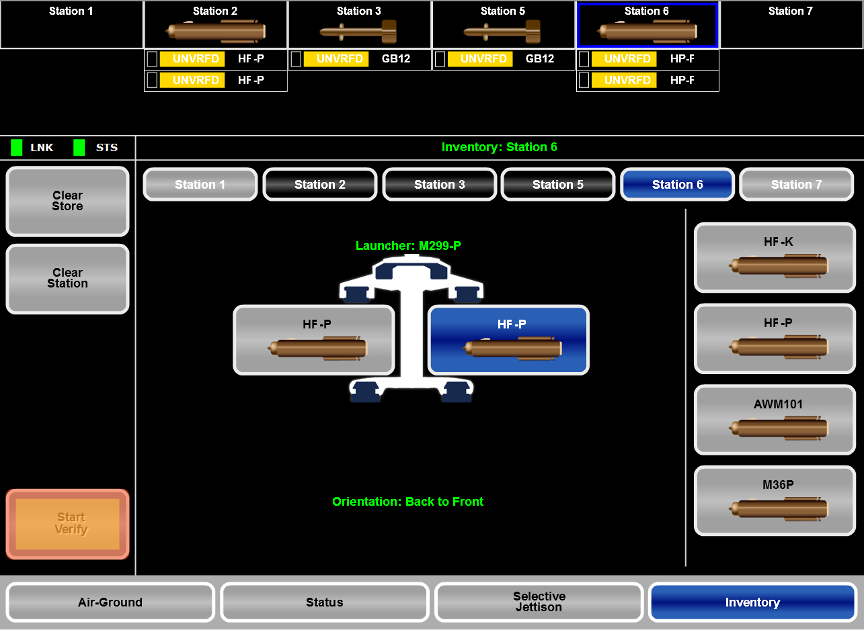

Slide 3








2
5
Rack: BRU-15

Slide 4
